Slide 1

Netflix Movies Data Analysis in SQL
Done By:
JESHWANTH

Slide 2
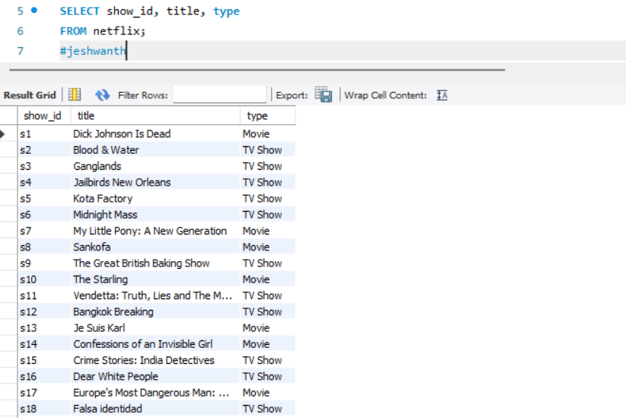
1. Write a query to list all titles with their show_id, title, and type.

Slide 3
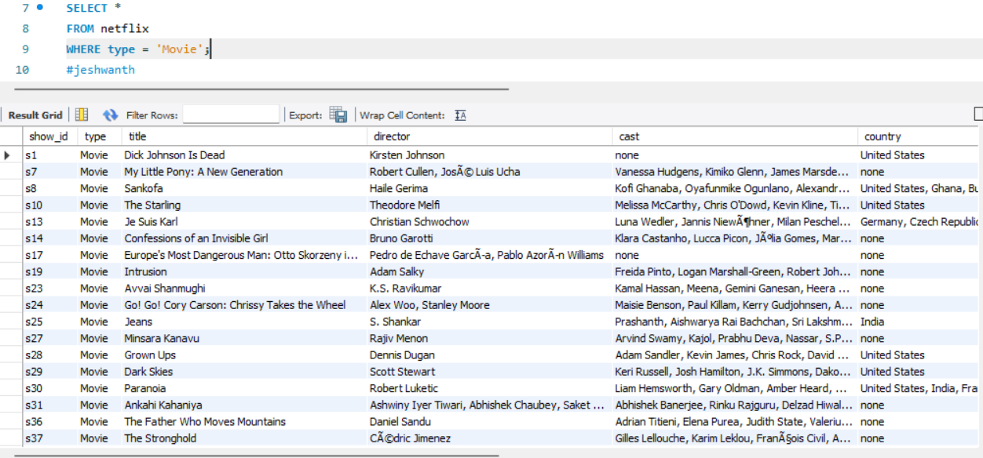
2. Write a query to display all columns for titles that are Movies.

Slide 4
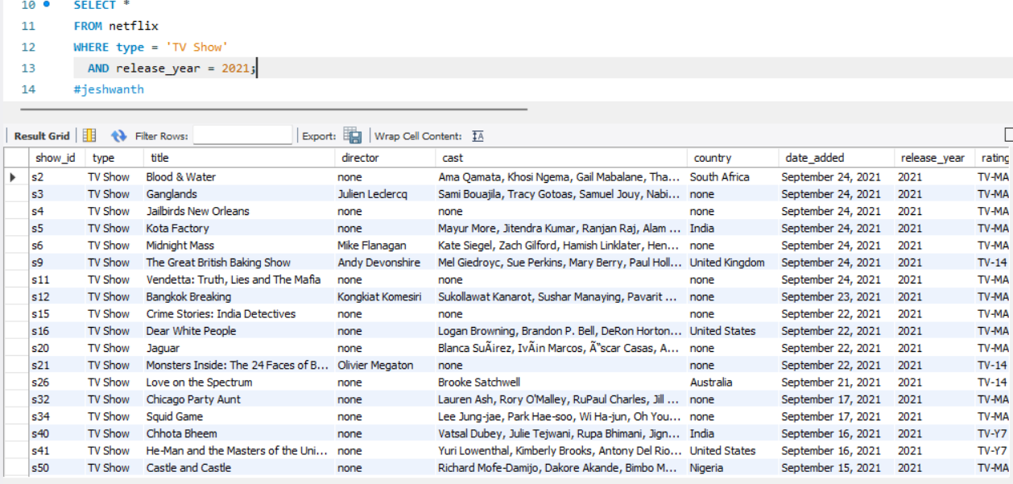
3. Write a query to list TV shows that were released in the year 2021.

Slide 5
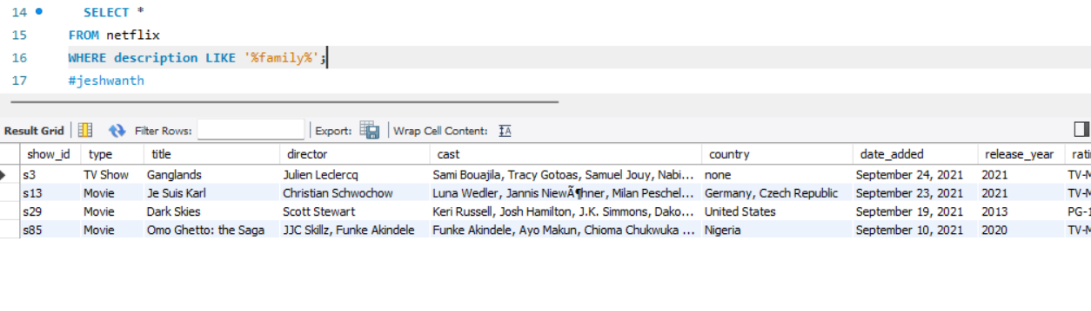
4.Write a query to find all titles where the description contains the word family.

Slide 6
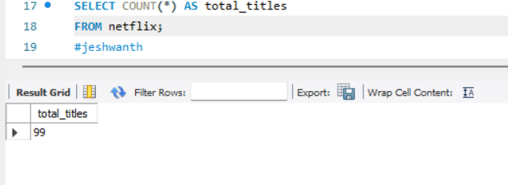
5. Write a query to count the total number of titles in the dataset.

Slide 7
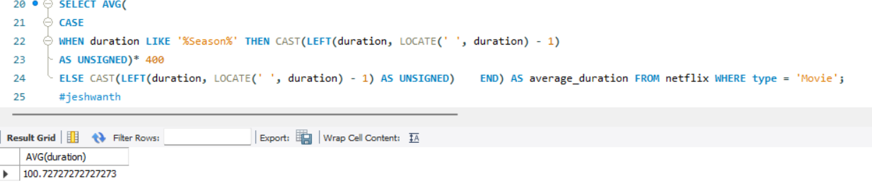
6. Write a query to find the average duration of all movies (in minutes, wherever the season is mentioned, consider 400 minutes per season).

Slide 8
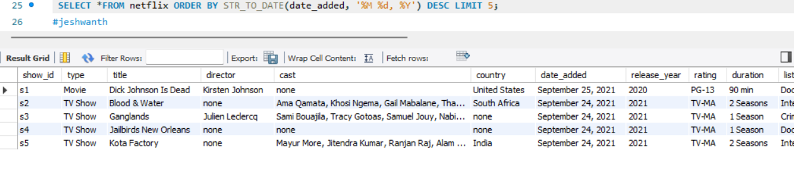
7. List the top 5 latest titles based on the date_added, sorted in descending order.

Slide 9
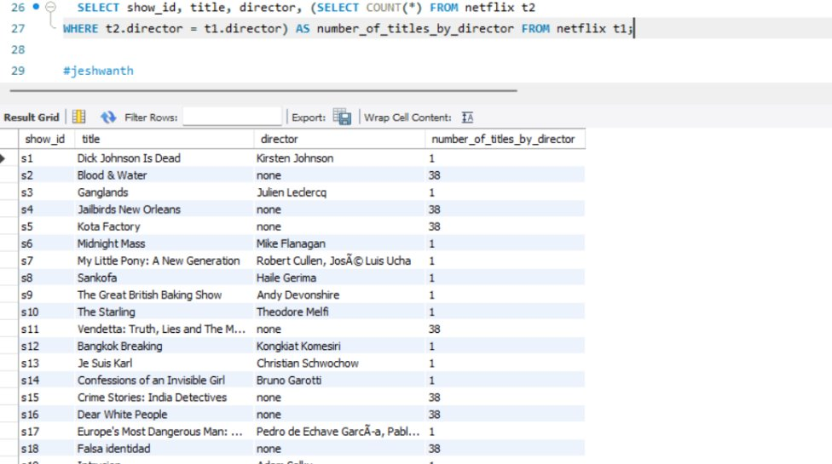
8. List all titles along with the number of other titles by the same director.

Slide 10
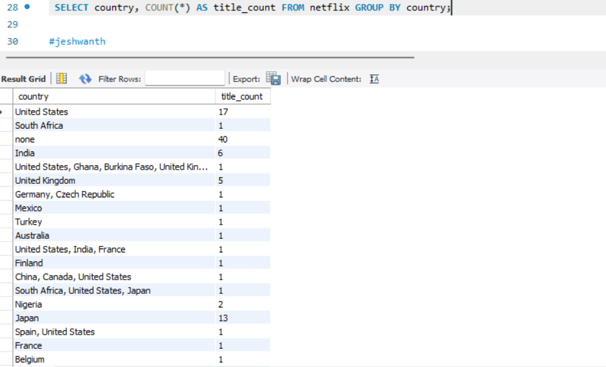
9. Find the total number of titles for each country.

Slide 11
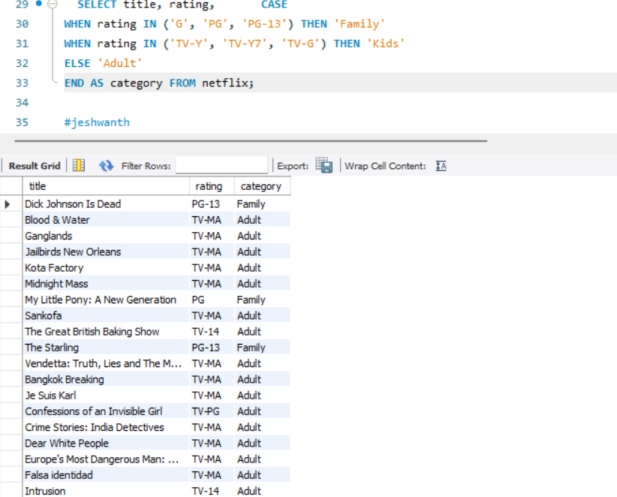
10. Categorize titles into Family, Kids, and Adult based on their rating using a CASE statement.

Slide 12
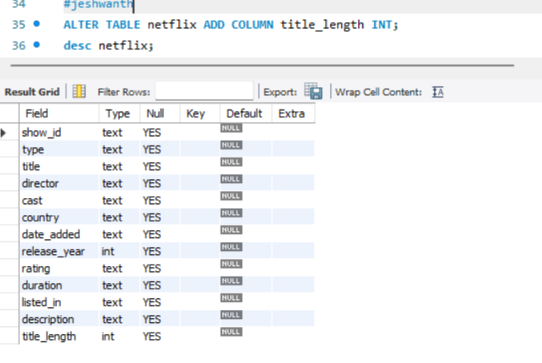
11. Add a new column title_length to the titles table that calculates the length of each title.

Slide 13
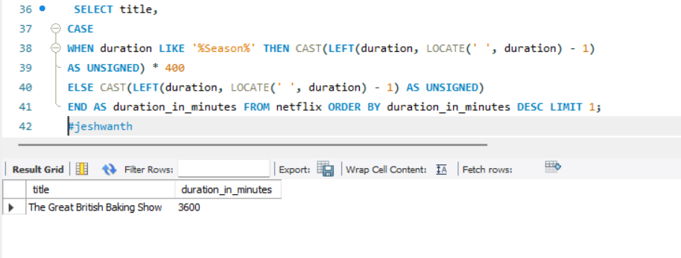
12. Find the title with the longest duration in minutes.

Slide 14
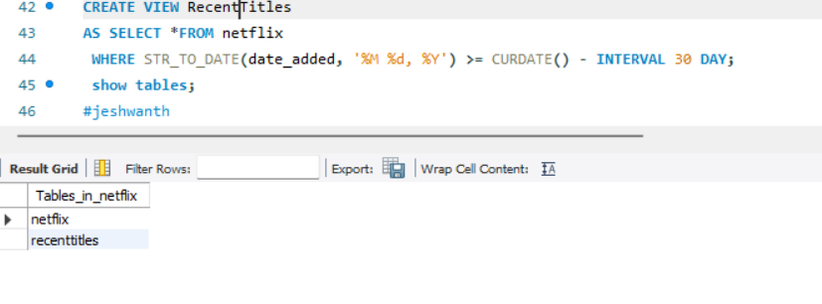
13. Create a view named RecentTitles that includes titles added in the last 30 days.

Slide 15
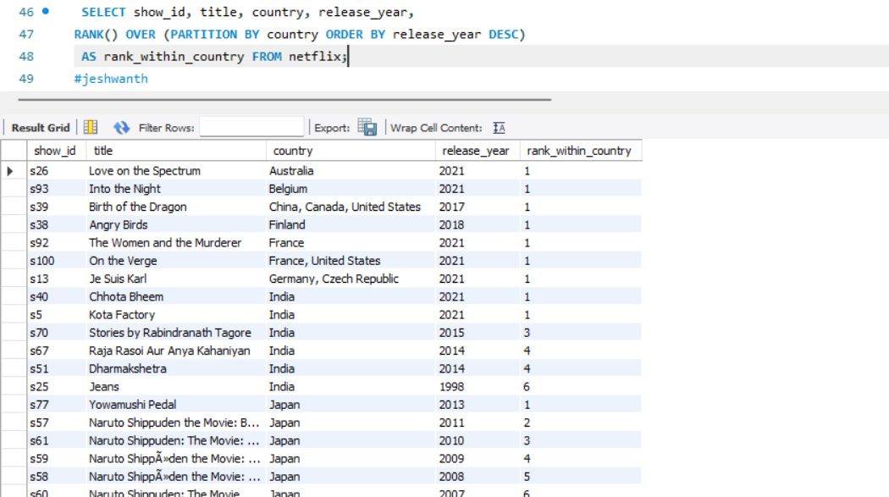
14. Rank titles based on their release_year within each country using a window function.

Slide 16
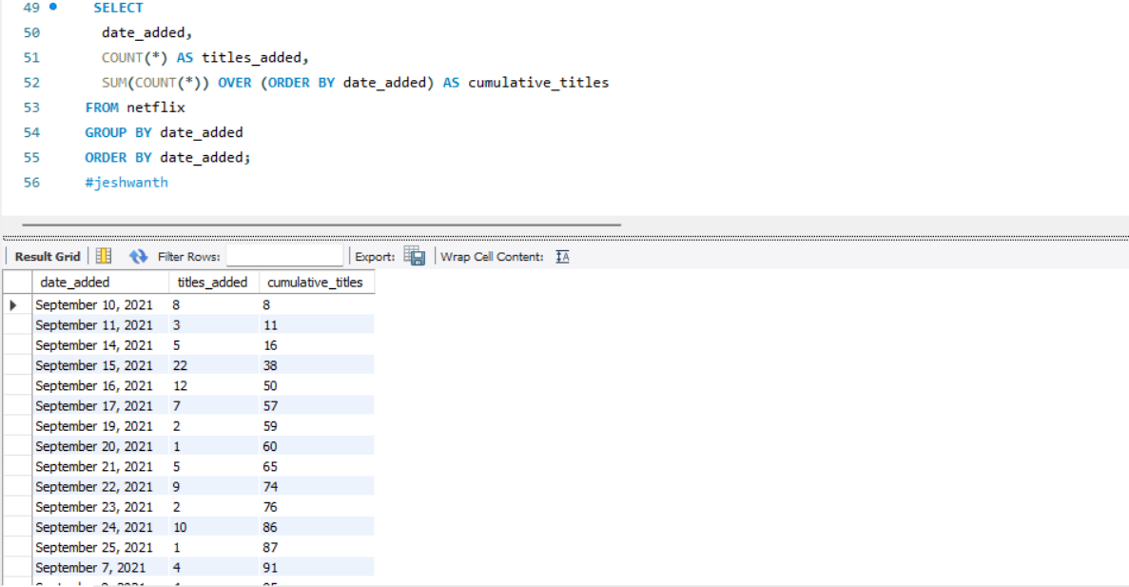
15. Calculate the cumulative count of titles added each month sorted by date_added

Slide 17
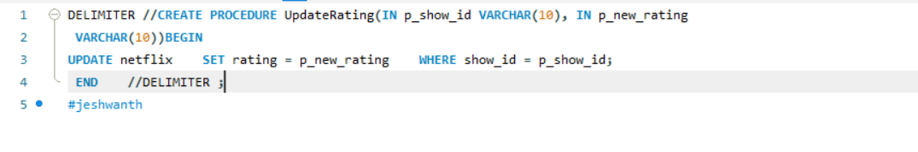
16. Create a stored procedure to update the rating of a title given its show_id and new rating.

Slide 18
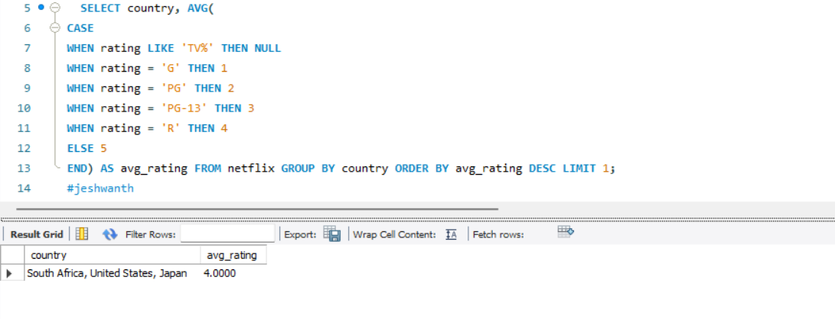
17. Find the country with the highest average rating for titles.

Slide 19
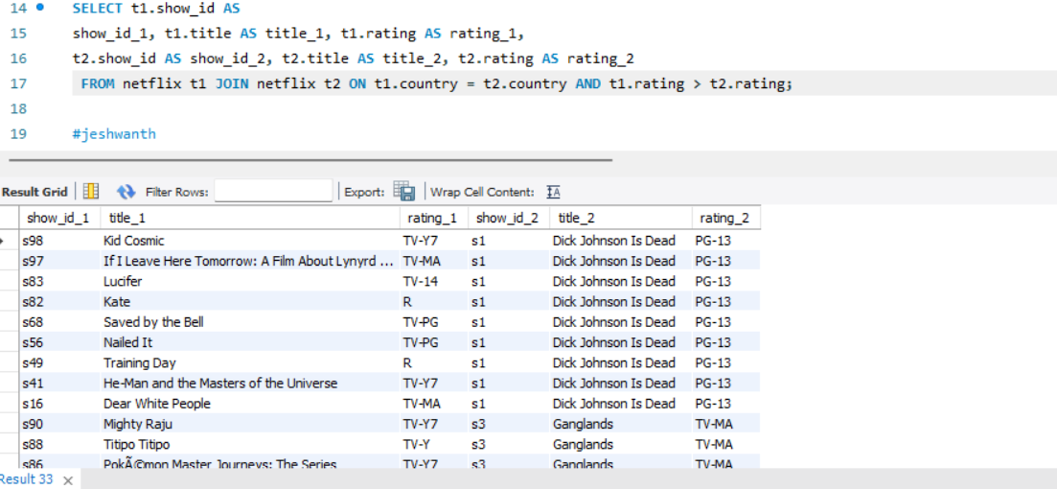
18. Find pairs of titles from the same country where one title has a higher rating than the other.

Slide 20
Conclusion
Top Insights:
•Shows that dominates as the top country.
•Content releases peaked in 2021.
•Majority of movies cater to mature audiences (TV-MA).
Future Work:
Integrate user ratings for quality analysis.

Slide 21
THANK YOU!

